Slide 1
Computer Networks Introduction
P. Krishna Reddy
IIIT Hyderabad

Slide 2


Slide 3
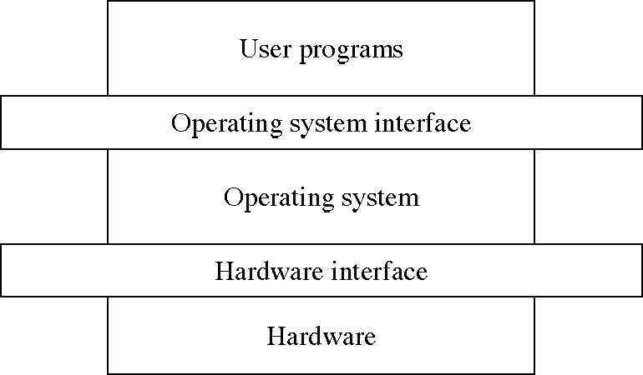
Topics completed: Operating system
Input: hardware
Output is system calls to develop applications
Objectives: to improve throughput and response time, deadlines, waiting time

Slide 4
Topics to be completed: Networking
Input: thousands of computers connected through communication channels
Output is primitives to develop applications
Objectives: to improve throughput, reliability, and response time, deadlines, waiting time
Networking Applications (http, sendmail,…)
Networking Protocols to implement system calls with code (Interface)
Tens of thousands of computers and devices connected through communication channels distributed across the world (thousands of kilometers

Slide 5
How it is different from producer and consumer problem?
Producer places an item and consumer consumes an item from the buffer.
Normally in the same computer
Producer waits if the buffer is full, consumer waits if buffer is empty.
How to enable producer and consumer to exchange data, suppose a video if
Producer is in one computer
Consumer is another computer
Connected through long communication channel (thousands of kilometers) with intermediate links and junctions
Issues
Links might not be reliable
All the data may not be delivered
So, more mechanisms are needed.
Requires
Error control mechanisms
Flow control mechanisms

Slide 6
Layered model
Layered model
Divide the roles/issues among layers
Develop each layer
Lower layer provides services to higher layer.

Slide 7
Structure view: layered system design
A general philosophy that builds on the above approach
Decompose functionality into layers such that
Hardware is level 0, and layer t accesses functionality at layer (t-1) or less
Access via appropriately defined system calls.
Advantages
Modular design: well defined interfaces between layers
Prototyping/development
Association between function and layer eases overall OS design.
OS development and debugging is layer by layer.
Simplifies debugging and system verification
New
operations
Layer M
Hidden
operations
Layer
M-1
Existing
operations

Slide 8
Layered Approach
The operating system is divided into a number of layers (levels), each built on top of lower layers. The bottom layer (layer 0), is the hardware; the highest (layer N) is the user interface.
With modularity, layers are selected such that each uses functions (operations) and services of only lower-level layers
Notes:
8

Slide 9
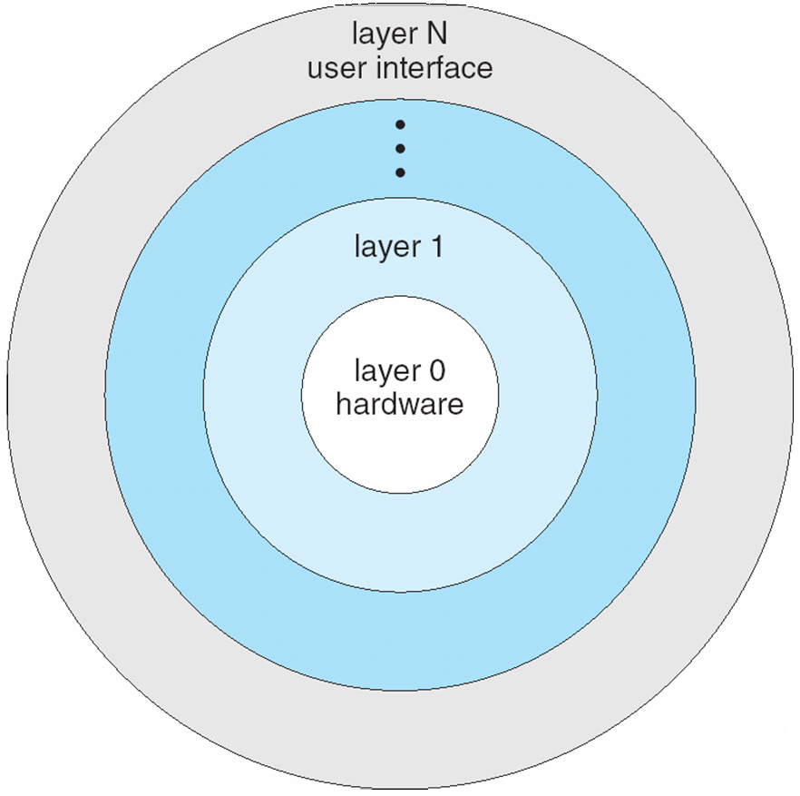
Layered Operating System
Notes:
9

Slide 10
OS design hierarchy: hypothetical model
Level | Name | Objects | Example operations
15 | Shell | User programming environment | Statements in shell language
14 | Directories (maintains association between external and internal identifiers of system resources and objects) | Directories | Create, destroy, search, list, access rights
13 | User Processes | User process | Fork, quit, kill, suspend, resume
12 | Stream I/O | streams | open., close
11 | Devices (access to external devices) | Printers, displays, and key boards | Create, destroy, open, close, read, write
10 | File system (long storage of named files) | files | Create, destroy, open, close
9 | Communications | pipes | Create, destroy, open, close, read, write
8 | Capabilities | Capabilities | Create, Validate, Attenuate
7 | Virtual memory (creating logical address space for programs) | Segments, pages | Read, write, fetch
6 | Local secondary storage (position of read/write heads) | Blocks of data, device channels | Read, write, allocate, free
5 | Primitive processes | Primitive process, semaphores, synchronization premitives | Suspend, resume, wait, signal
4 | Interrupts | Interrupts handling programs | Invoke, mask, unmask, retry
3 | Procedures | Procedures, call stack | Mark stack, call, return
2 | Instruction set | Evaluation, stack, micro-program, interpreter | Load, store, add, subtract, branch
1 | Electronic circuits | Registers, gates, busses | Clear, transfer, activate, complement

Slide 11
Overview of this chapter
Introduction
Uses of Computer Networks
Network Hardware
Network Software
Reference Models
Example Networks
Network Standardization
Metric Units

Slide 12
Introduction
18th century is dominated by mechanical systems
19th century is the age of steam engine
20th century- Information Technology
Information gathering processing and distribution
Others: radio, television, telephones, communication satellites and Internet
Computer network
Large number of separate but interconnected computers.
Distributed system: A collection of independent computers which appears to users as single coherent system. Another layer such as world wide web is presented on the top of computer network
In computer network, users are exposed to machines.

Slide 13
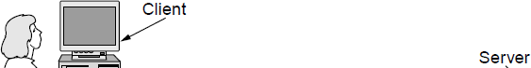
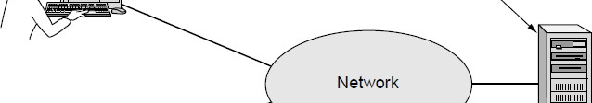

Users of computer networks
Business applications
Resource sharing
To make programs, equipment, and data available to anyone on the network without regard to the location of the user.
Almost every office requires computer networks

Slide 14
Home Applications
Homes contain many networked devices, e.g., computers, TVs, connected to the Internet by cable, DSL, wireless, etc.
Home users communicate, e.g., social networks, consume content, e.g., video, and transact, e.g., auctions
Wikipedia, facebook, twitter, sms, IP television
Some application use the peer-to-peer model in which there are no fixed clients and servers:
In a peer-to-peer system there are no fixed clients and servers.

Slide 15
Tag | Full name | Example
B2C | Business-to-consumer | Ordering books online
B2B | Business-to-business | Car manufacturer ordering tires from supplier
G2C | Government-to-consumer | Government distributing tax forms electronically
C2C | Consumer-to-consumer | Auctioning second-hand products online
P2P | Peer-to-peer | Music sharing
Some forms of e-commerce.

Slide 16
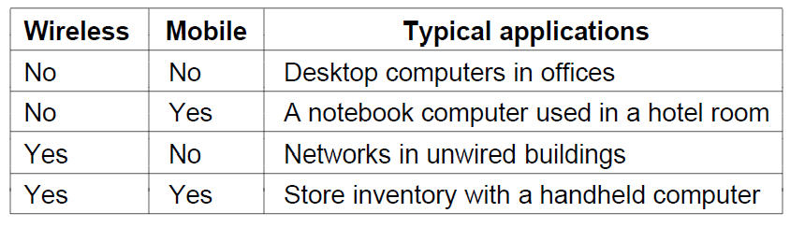
Mobile Users
Tablets, laptops, and smart phones are popular devices; WiFi hotspots and 3G cellular provide wireless connectivity.
Mobile users communicate, e.g., voice and texts, consume content, e.g., video and Web, and use sensors, e.g., GPS.
Sensor networks
Wireless and mobile are related but different:

Slide 17
Social Issues
Network neutrality – no network restrictions
Content ownership, e.g., DMCA (Digital Millennium Copy right Act) takedowns
Anonymity and censorship
Privacy, e.g., Web tracking and profiling
Theft, e.g., botnets and phishing

Slide 18
Network Hardware
Scale | Type
Vicinity | PAN (Personal Area Network) »
Building | LAN (Local Area Network) »
City | MAN (Metropolitan Area Network) »
Country | WAN (Wide Area Network) »
Planet | The Internet (network of all networks)
Networks can be classified by their scale:

Slide 19
About networking technology
Two dimensions
Transmission technology
Scale
Two types of transmission technology
Broadcast links
Point to point links
Point-to-Point links
One sender and one receiver
Connect individual pairs of links
They may have to visit some intermediate machines.
Broadcast link
Communication link is shared by several machines
A packet is received by all machines. The address in the packet specified intended recipient.
Broadcasting: message is sent to all machines
Multicasting: message is sent to a subset of nodes.

Slide 20
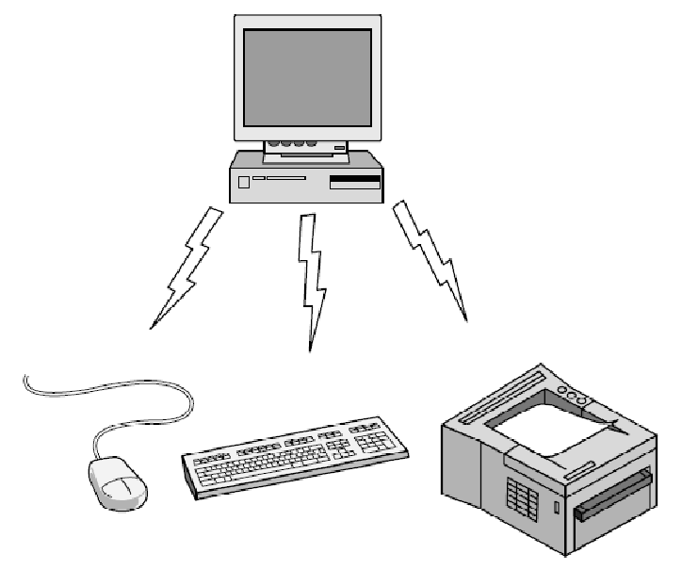
Personal Area Network
Connect devices over the range of a person
Example of a Bluetooth (wireless) PAN:

Slide 21
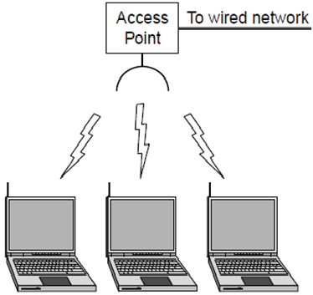
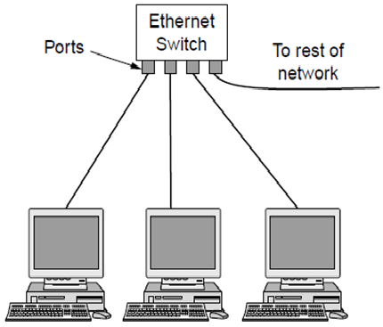
Local Area Networks
Connect devices in a home or office building
Called enterprise network in a company
Wireless LAN with 802.11
Wired LAN with switched Ethernet

Slide 22
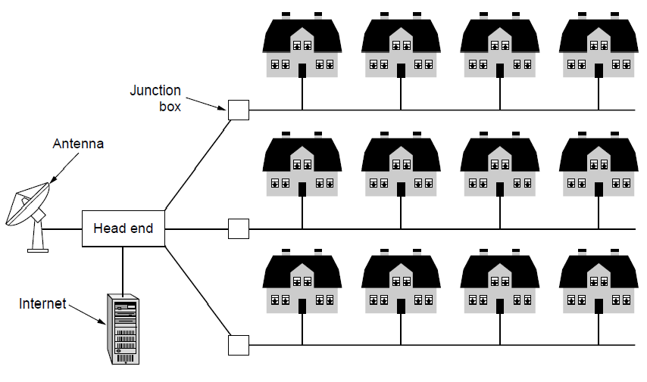
Metropolitan Area Networks
Connect devices over a metropolitan area
Example MAN based on cable TV:

Slide 23
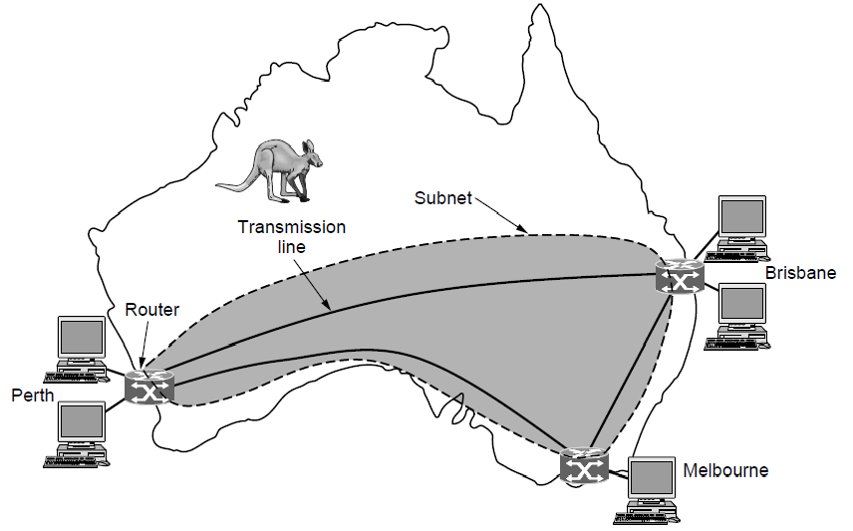
Wide Area Networks (1)
Connect devices over a country
Example WAN connecting three branch offices:

Slide 24
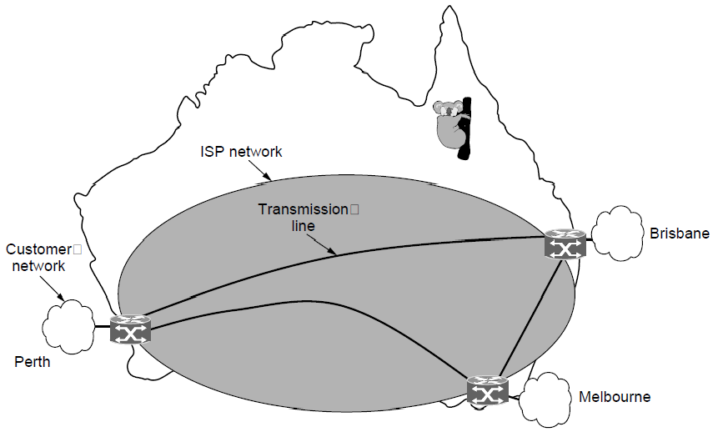
Wide Area Networks (2)
An ISP (Internet Service Provider) network is also a WAN.
Customers buy connectivity from the ISP to use it.

Slide 25
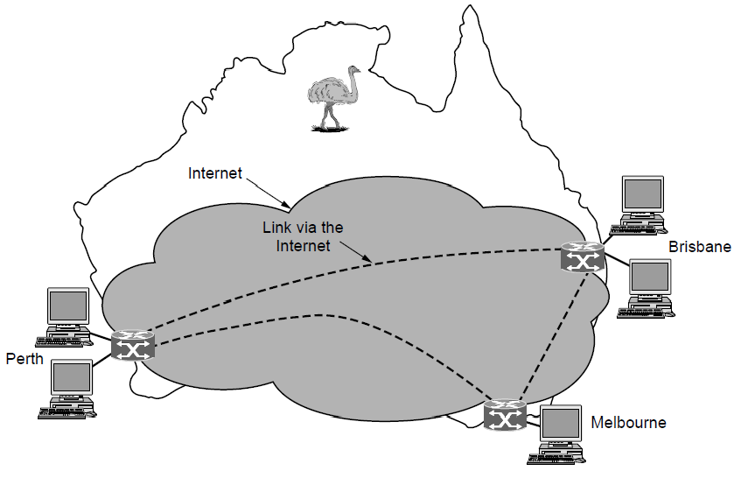
Wide Area Networks (3)
A VPN (Virtual Private Network) is a WAN built from virtual links that run on top of the Internet.

Slide 26
Network Software
Protocol layers »
Design issues for the layers »
Connection-oriented vs. connectionless service »
Service primitives »
Relationship of services to protocols »

Slide 27
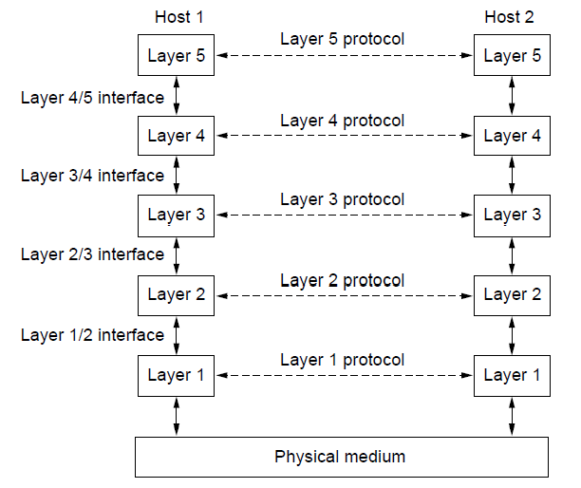
Protocol Layers (1)
Protocol layering is the main structuring method used to divide up network functionality.
Each protocol instance talks virtually to its peer
Each layer communicates only by using the one below
Lower layer services are accessed by an interface
At bottom, messages are carried by the medium

Slide 28
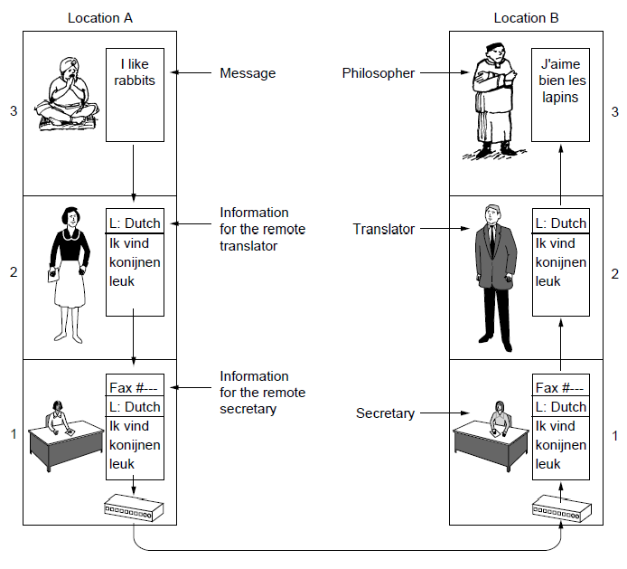
Protocol Layers (2)
Example: the philosopher-translator-secretary architecture
Each protocol at different layers serves a different purpose

Slide 29
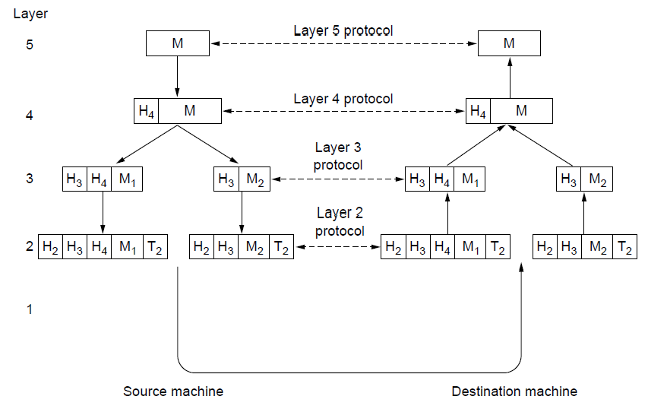
Protocol Layers (3)
Each lower layer adds its own header (with control inform- ation) to the message to transmit and removes it on receive
Layers may also split and join messages, etc.

Slide 30
Design Issues for the Layers
Each layer solves a particular problem but must include mechanisms to address a set of recurring design issues
Issue
Example mechanisms at different layers
Reliability despite failures
Codes for error detection/correction (§3.2, 3.3) Routing around failures (§5.2)
Network growth and evolution
Addressing (§5.6) and naming (§7.1) Protocol layering (§1.3)
Allocation of resources like bandwidth
Multiple access (§4.2) Congestion control (§5.3, 6.3)
Security against various threats
Confidentiality of messages (§8.2, 8.6) Authentication of communicating parties (§8.7)

Slide 31

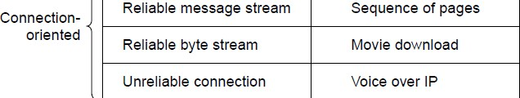
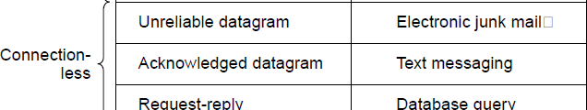
Connection-Oriented vs. Connectionless
Service provided by a layer may be kinds of either:
Connection-oriented, must be set up for ongoing use (and torn down after use), e.g., phone call
Connectionless, messages are handled separately, e.g., postal delivery

Slide 32
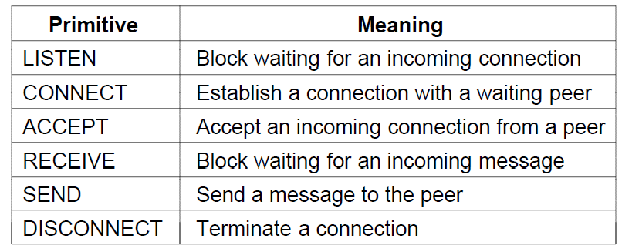
Service Primitives (or system calls (1))
A service is provided to the layer above as primitives
Hypothetical example of service primitives that may provide a reliable byte stream (connection-oriented) service:

Slide 33
Service Primitives (2)
Hypothetical example of how these primitives may be used for a client-server interaction
Client Server
LISTEN (0)
CONNECT (1)
Connect request
ACCEPT ₍₂₎
Accept response Request for data
RECEIVE
SEND ₍₃₎
RECEIVE
SEND (4)
Reply Disconnect
DISCONNECT (5)
DISCONNECT (6)
Disconnect

Slide 34
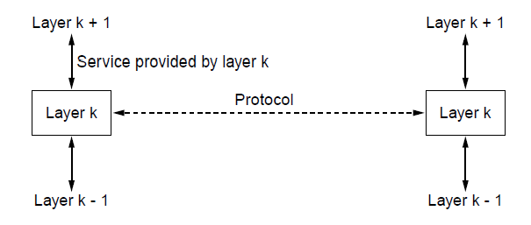
Relationship of Services to Protocols
Recap:
A layer provides a service to the one above [vertical]
A layer talks to its peer using a protocol [horizontal]

Slide 35
Reference Models
Reference models describe the layers in a network architecture
OSI reference model »
TCP/IP reference model »
Model used for this text »
Critique of OSI and TCP/IP »

Slide 36
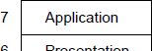
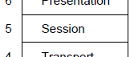
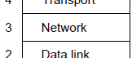
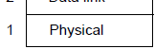
OSI (Open Systems Interconnection) Reference Model
A principled, international standard, seven layer model to connect different systems
Provides functions needed by users Converts different representations
Manages task dialogs
Provides end-to-end delivery
Sends packets over multiple links
Sends frames of information
Sends bits as signals
ISO OSI: International Standards Organization Open Systems Interconnection

Slide 37
About Layers
The Physical layer
Transmitting raw bits over a communication channel
One side sends 1/0 and the other side receives 1/0
Issue: What electrical signals should be used?
Design issues
Mechanical, electrical and timing interfaces
The Data Link Layer
Transform a raw transmission facility into a like that appears free of undetected transmission errors.
Data frame and ack. Frame
Interface between fast transmitter and slow receiver
Broadcast networks: How to control access to shared channel?
LAN
The network layer
Controls the operation of the subnet.
Issue: how packets are routed from source to destination?
Resolving bottlenecks; concession control
In broadcast networks, network layer is absent

Slide 38
About Layers
The Session Layer
Helps to establish sessions
Dialog control, token management, synchronization
The presentation layer
Syntax and semantics of the information
It allows computers with different data representations to communicate
The application layer
Set of protocols
Popular one is HTTP (Hypertext transfer protocol)
File transfer
Electronic mail
Network news
The Transport layer
Accept data split into small units, if required, and pass it to network layer.
It isolates upper layer with the possible changes in the hardware technology.
It also determines the type of service: connection oriented or connectionless.
It is an end to end layer
One computer talks with other computer
In the lower layers the communication is between the source and intermediate computer.

Slide 39
The OSI reference model.

Slide 40
TCP/IP Reference Model
A four layer model derived from experimentation; omits some OSI layers and uses the IP as the network layer.
TCP/IP stands for Transmission Control Protocol/Internet Protocol and is a suite of
communication protocols used to interconnect network devices on the internet.
ICMP: Internet Control Message Protocol
UDP: User Datagram Protocol
DSL: Digital subscriber line
SONET: Synchronous Optical Network
SMTP: Simple Mail Transfer Protocol
RTP: Realtime transport protocol
DNS: Domain name system
“ ”
The TCP/IP model with some protocols we will study.

Slide 41
The TCP/IP reference model.

Slide 42
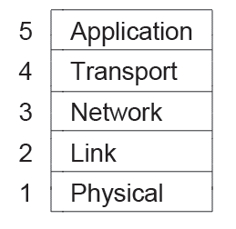
Model Used in this Book
It is based on the TCP/IP model but we call out the physical layer and look beyond Internet protocols.

Slide 43
Critique of OSI & TCP/IP
OSI:
+ Very influential model with clear concepts
Models, protocols and adoption all bogged down by politics and complexity
TCP/IP:
+ Very successful protocols that worked well and thrived
Weak model derived after the fact from protocols

Slide 44
Example Networks
The Internet »
3G mobile phone networks »
Wireless LANs »
RFID and sensor networks »

Slide 45
Internet
(a) Structure of the telephone system. (b) Baran's proposed distributed switching system.

Slide 46
Internet
The original ARPANET design.
ARPANET: Advanced Research Projects Agency Network
IMP: Interface message processors

Slide 47
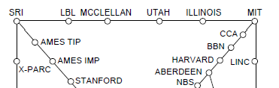
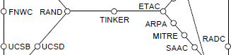
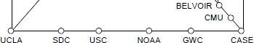
Internet
Before the Internet was the ARPANET, a decentralized, packet-switched network based on Baran’s ideas.
DNS evolved (Domain name system)
A generalized distributed database system for storing variety of information related to naming.
Nodes are IMPs, or early routers, linked to hosts
56 kbps links
ARPANET topology in Sept 1972.

Slide 48
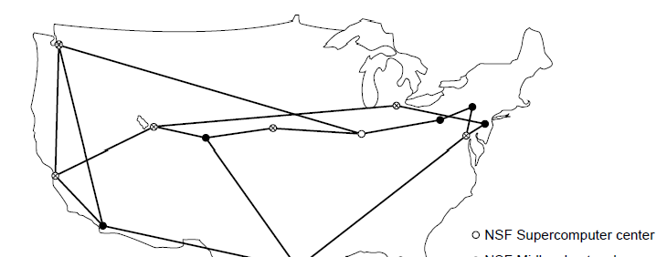
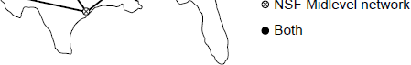
Internet
The early Internet used NSFNET (1985-1995) as its backbone; universities connected to get on the Internet
T1 links (1.5 Mbps)
NSFNET topology in 1988
NSFNET: National Science Foundation Network

Slide 49
Internet
The modern Internet is more complex:
ISP networks serve as the Internet backbone
ISPs connect or peer to exchange traffic at IXPs
Within each network routers switch packets
Between networks, traffic exchange is set by business agreements
Customers connect at the edge by many means
− Cable, DSL, Fiber-to-the-Home, 3G/4G wireless, dialup
Data centers concentrate many servers (“the cloud”)
Most traffic is content from data centers (esp. video)
The architecture continues to evolve

Slide 50
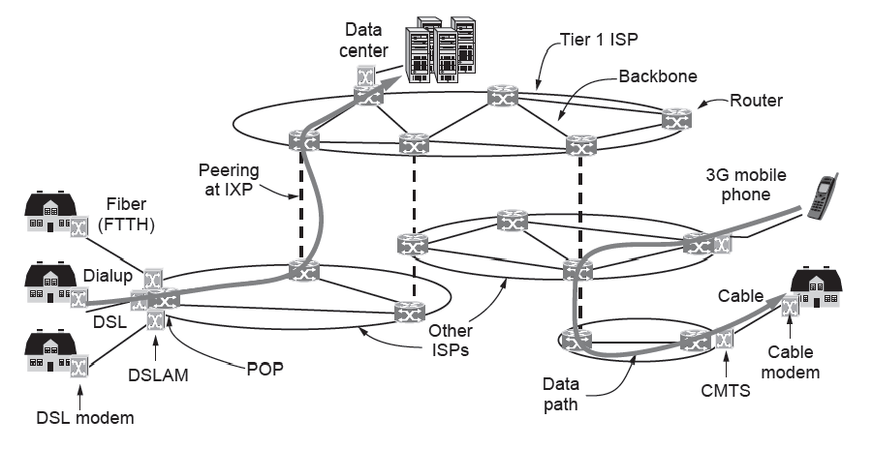
Internet (4)
Architecture of the Internet
DSLAM (Digital Subscriber Line Access Multiplexer)
Fiber to the home (FTTH)
A cable modem termination system (CMTS)
Internet eXchange Point (IXP) : Internet Exchange Point (IXP) can earn money by charging each ISP that connects to it. The IXP charges each ISP based on the amount of traffic sent to or received from the IXP.

Slide 51
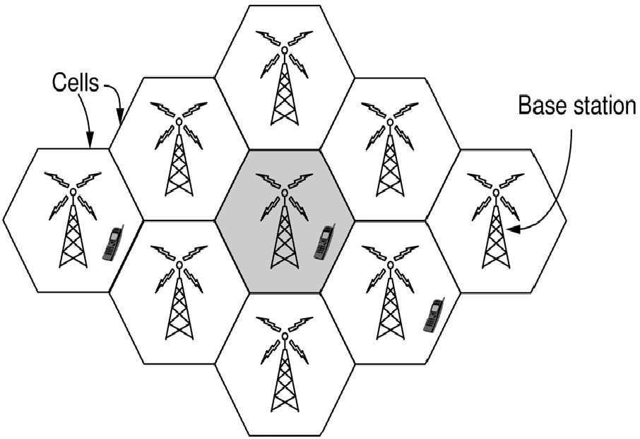
3G Mobile Phone Networks (1)
3G stands for third generation
Evolved due to scarcity of spectrum
3G network is based on spatial cells; each cell provides wireless service to mobiles within it via a base station
Coverage area is divided into cells.
Within a cell, users are assigned channels which do not interfere with each other and do not cause much interference to adjacent cells.

Slide 52
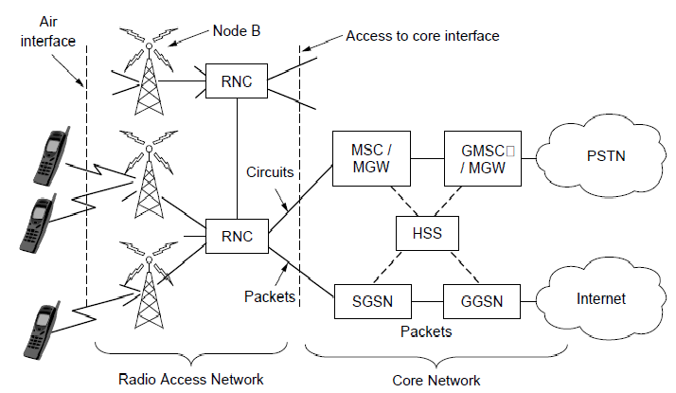
3G Mobile Phone Networks (2)
Base stations connect to the core network to find other mobiles and send data to the phone network and Internet

Slide 53
3G mobile networks
Air interface
It is based on UMTS (Universal Mobile Telecommunication System) or WCDMA (Wideband code division multiple access)
Can provide 14Mbps downlink and 6Mbps uplink
Cellular base station together with the controller forms radio access network
The controller node RNC (Radio Network Controller) controls the spectrum used.
The rest of the mobile network carries traffic, which is called core network
MSC: mobile switching center
GMSC: Gateway mobile switching center
MGW: media gateway
PSTN: Public switched telephone network
Data services
GPRS General Packet Radio Service
SGSN: Serving GPRS support node
GGSN: Gateway GPRS support node
SIM card
Subscriber Identify module (SIM)
4G
LTE (Long term evolution)
WiMAX
It can support both connection oriented and connectionless

Slide 54
3G mobile networks
Air interface
It is based on UMTS (Universal Mobile Telecommunication System) or WCDMA (Wideband code division multiple access)
Can provide 14Mbps downlink and 6Mbps uplink
Cellular base station together with the controller forms radio access network
The controller node RNC (Radio Network Controller) controls the spectrum used.
The rest of the mobile network carries traffic, which is called core network
MSC: mobile switching center
GMSC: Gateway mobile switching center
MGW: media gateway
PSTN: Public switched telephone network
Data services
GPRS General Packet Radio Service
SGSN: Serving GPRS support node
GGSN: Gateway GPRS support node
SIM card
Subscriber Identify module (SIM)
4G
LTE (Long term evolution)
WiMAX
It can support both connection oriented and connectionless

Slide 55
3G mobile networks
First generation - 1G 1980s: 1G delivered analog voice.
Second generation - 2G Early 1990s: 2G introduced digital voice (e.g. CDMA- Code Division Multiple Access).
Third generation - 3G Early 2000s: 3G brought mobile data (e.g. CDMA2000).
Fourth generation - 4G LTE 2010s: 4G LTE ushered in the era of mobile broadband.
Long Term Evolution (LTE) is a 4G wireless communication standard that's designed to provide the fastest internet speeds for smartphones, tablets and other mobile devices. Unlike 3G that uses microwaves, 4G utilizes radio waves, which allows better area coverage and penetration through surfaces
5G (https://www.qualcomm.com/5g/what-is-5g)
1G, 2G, 3G, and 4G all led to 5G, which is designed to provide more connectivity than was ever available before.
5G is a unified, more capable air interface. It has been designed with an extended capacity to enable next-generation user experiences, empower new deployment models and deliver new services.
With high speeds, superior reliability and negligible latency, 5G will expand the mobile ecosystem into new realms. 5G will impact every industry, making safer transportation, remote healthcare, precision agriculture, digitized logistics — and more — a reality.

Slide 56
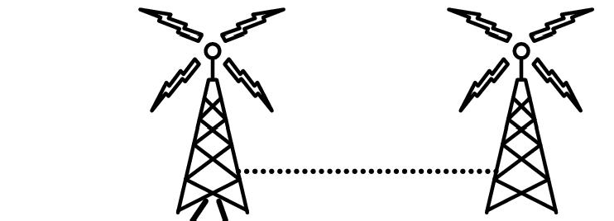


3G Mobile Phone Networks (3)
As mobiles move, base stations hand them off from one cell to the next, and the network tracks their location
Handover

Slide 57
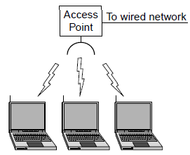
Wireless LANs (1)
In 802.11, clients communicate via an AP (Access Point) that is wired to the rest of the network.

Slide 58
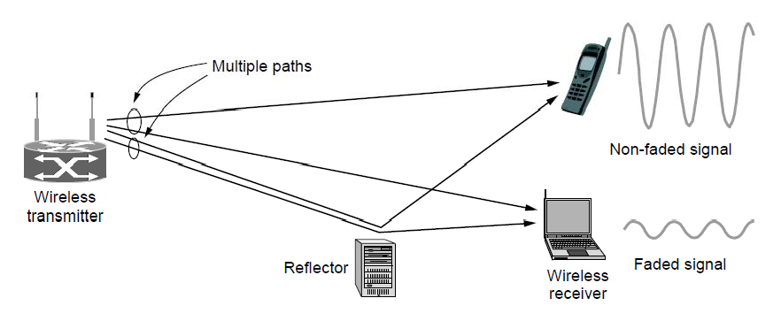
Wireless LANs (2)
Signals in the 2.4GHz ISM band vary in strength due to many effects, such as multipath fading due to reflections
− requires complex transmission schemes, e.g., OFDM

Slide 59
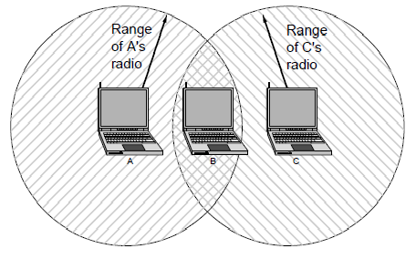
Wireless LANs (3)
Radio broadcasts interfere with each other, and radio ranges may incompletely overlap
− CSMA (Carrier Sense Multiple Access) designs are used

Slide 60
RFID and Sensor Networks (1)
RFID: Radio Frequency Identification
Passive UHF RFID networks everyday objects:
Tags (stickers with not even a battery) are placed on objects
Readers send signals that the tags reflect to communicate Tags communicate at distances of several meters
HF RFID is short range, 1 meter
LF RFID is used for animal tracking
RFID used t o network everyday objects.

Slide 61
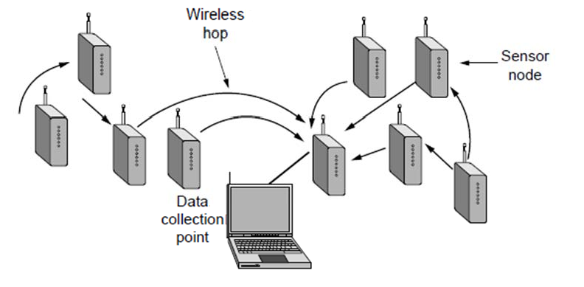
RFID and Sensor Networks (2)
Sensor networks spread small devices over an area:
− Devices send sensed data to collector via wireless hops
Sensor nodes are small computers which has the temperature, pressure, vibration and other sensors.
They have batteries. They can also harvest energy from Sun
They can communicate with each other. One of the node can become hop.
Organized into a multihop network

Slide 62
Network Standardization
Standards define what is needed for interoperability
Some of the many standards bodies:
Body | Area | Examples
ITU | Telecommunications | G.992, ADSL H.264, MPEG4
IEEE | Communications | 802.3, Ethernet 802.11, WiFi
IETF | Internet | RFC 2616, HTTP/1.1 RFC 1034/1035, DNS
W3C | Web | HTML5 standard CSS standard
ITU: International Telecommunications Union.
IRTF: Internet Research Task Force
IETF: Internet Engineering Task Force
iAB: Internet Architecture Board

Slide 63
Metric Units
The main prefixes we use:
Prefix | Exp. | prefix | exp.
K(ilo) | 10³ | m(illi) | ₁₀-3
M(ega) | 10⁶ | μ(micro) | ₁₀-6
G(iga) | 10⁹ | n(ano) | ₁₀-9
Use powers of 10 for rates, powers of 2 for storage
− E.g., 1 Mbps = 1,000,000 bps, 1 KB = 1024 bytes
“B” is for bytes, “b” is for bits
Exp. | Explicit | Prefix | Exp. | Explicit | Prefix
10⁻³ | 0.001 | milli | 10³ | 1,000 | Kilo
10⁻⁶ | 0.000001 | micro | 10⁶ | 1,000,000 | Mega
10⁻⁹ | 0.000000001 | nano | 10⁹ | 1,000,000,000 | Giga
10⁻¹² | 0.000000000001 | pico | 10¹² | 1,000,000,000,000 | Tera
10⁻¹⁵ | 0.000000000000001 | femto | 10¹⁵ | 1,000,000,000,000,000 | Peta
10⁻¹⁸ | 0.000000000000000001 | atto | 10¹⁸ | 1,000,000,000,000,000, 000 | Exa
10⁻²¹ | 0.000000000000000000001 | zepto | 10²¹ | 1,000,000,000,000,000,000,000 | Zetta
10⁻²⁴ | 0.000000000000000000000001 | yocto | 10²⁴ | 1,000,000,000,000,000,000,000,000 | Yotta

Slide 64
Summary
Computer networks have many uses
Companies and individuals
Networks can be divided into LANs, MANs, WANs and Internetworks.
Wireless networks such as 3G and 802.11 LANs are becoming popular.
Network software is built around protocols, the rules the processes communicate.
Protocols are based on OSI or TCP/IP model
TCP/IP
Link, network, transport and application layers
Design issues
Reliability, delay, resource allocation, growth, security, and more
Networks provide services
Connectionless best effort packet delivery
Connection oriented guaranteed delivery
Well-known networks
Internet, the 3G mobile phone network, 802.11 LANs
Internet is a collection of thousands of networks which employ TCP/IP stack
New kinds of networks
Embedded sensor networks, networks based on sensor technology
Standardization efforts
ITU-T, ISO, IEEE and IETF manage different parts of the standardization process.

